Slide 1

Department of Mechanical Engineering Indian Institute of Technology Tirupati
B. Tech Final Year Project Presentation
DESIGN AND FABRICATION OF EXPERIMENT FOR DYNAMIC ANALYSIS OF MECHANISMS
Aakash (ME16B001)
A. Akhil (ME16B003)
Supervised by
Dr. Sriram Sundar, Assistant Prof of ME
Date: 23-AUG-2019

Slide 2

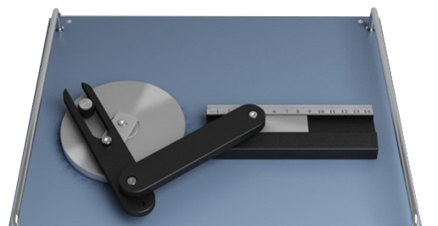
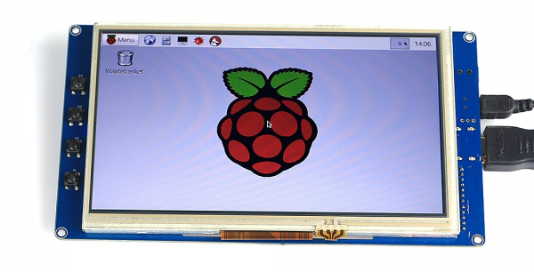
Introduction and Objectives
Dept. of Mechanical Engineering
B. Tech Final Year Project Presentation
To design and fabricate an experimental setup for static, kinematic and dynamic analysis of mechanism.
The setup will have retrofitted parts in order to let the student carry out multiple experiments in the same setup.
The experiment will supplement and reinforce the theoretical understanding of the undergraduate students taking the ME2206(KDM) by providing them the opportunity to match the analytical results with the actual experimental results.
source: ardubotics.com
source: sun labtech
Notes:
The field and/or area in which you will be working
(b) The aim and objectives of your work.
(c) The importance of your work and its applications

Slide 3
Plan
Dept. of Mechanical Engineering
B. Tech Final Year Project Presentation
Theoretical analysis
3D Modelling
Documentation
GeoGebra Modelling and sensor identification
Prototyping, Fabrication and Testing
Estimated budget : INR 25,000.00 - 30,000.00
Probable sensors for instrumentation: Rotary encoders, Ultrasonic range sensors, linear accelerometers, strain gauges

Slide 4

Mechanism
Dept. of Mechanical Engineering
B. Tech Final Year Project Presentation

Slide 5
Literature Review
Dept. of Mechanical Engineering
B. Tech Final Year Project Presentation
Kinematics and Dynamics of Machinery, Robert L. Norton
Theory of Mechanisms and Machines, Ghosh and Mallik
Theory of Machines and Mechanisms, Uicker, Pennock and Shigley

